Slide 1
Exploratory Analysis of Diphtheria in the US (1888–1981)
Kaushal Ameta (12400922)
Course: Data Visualization with R
Email: kaushal.ameta@stud.th-deg.de
Date: 12th July 2025

Slide 2
INTRODUCTION
Diphtheria (Corynebacterium diphtheriae) caused widespread childhood mortality before vaccines.
Vaccination campaigns in the 1920s–1940s led to a major decline.
This project explores:
Temporal trends in mortality
Seasonal patterns
Geographical hotspots
Vaccination impact

Slide 3
Research Questions
RQ1: How did mortality change before and after vaccination?
RQ2: What were seasonal patterns?
RQ3: Which locations had the highest burden?
RQ4: Can modeling quantify vaccination impact?

Slide 4
Data & Methods
Dataset: Project Tycho Level 2, 1888–1981
Key Techniques:
LOESS smoothing
STL decomposition
Changepoint detection
Interrupted Time Series Regression
ARIMA forecasting
Packages: tidyverse, forecast, changepoint, segmented, plotly, usmap, etc.

Slide 5
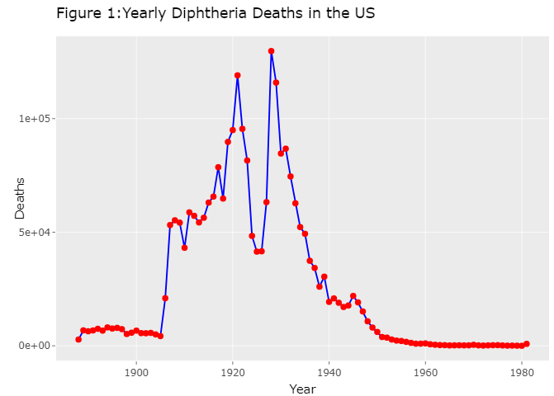
Yearly Deaths Over Time
Annual counts show high mortality pre-1940.
Red dots are showing years.
Clear decline after vaccine introduction.
Supports RQ1: Temporal Trends.

Slide 6
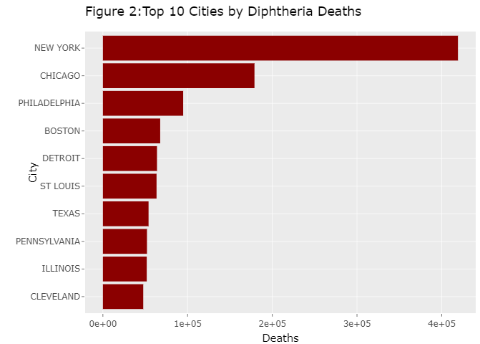
Top 10 Cities by Total Deaths
Geographic clustering of mortality.
Largest burden in major urban centers.
Addresses RQ3: Spatial Disparities.

Slide 7
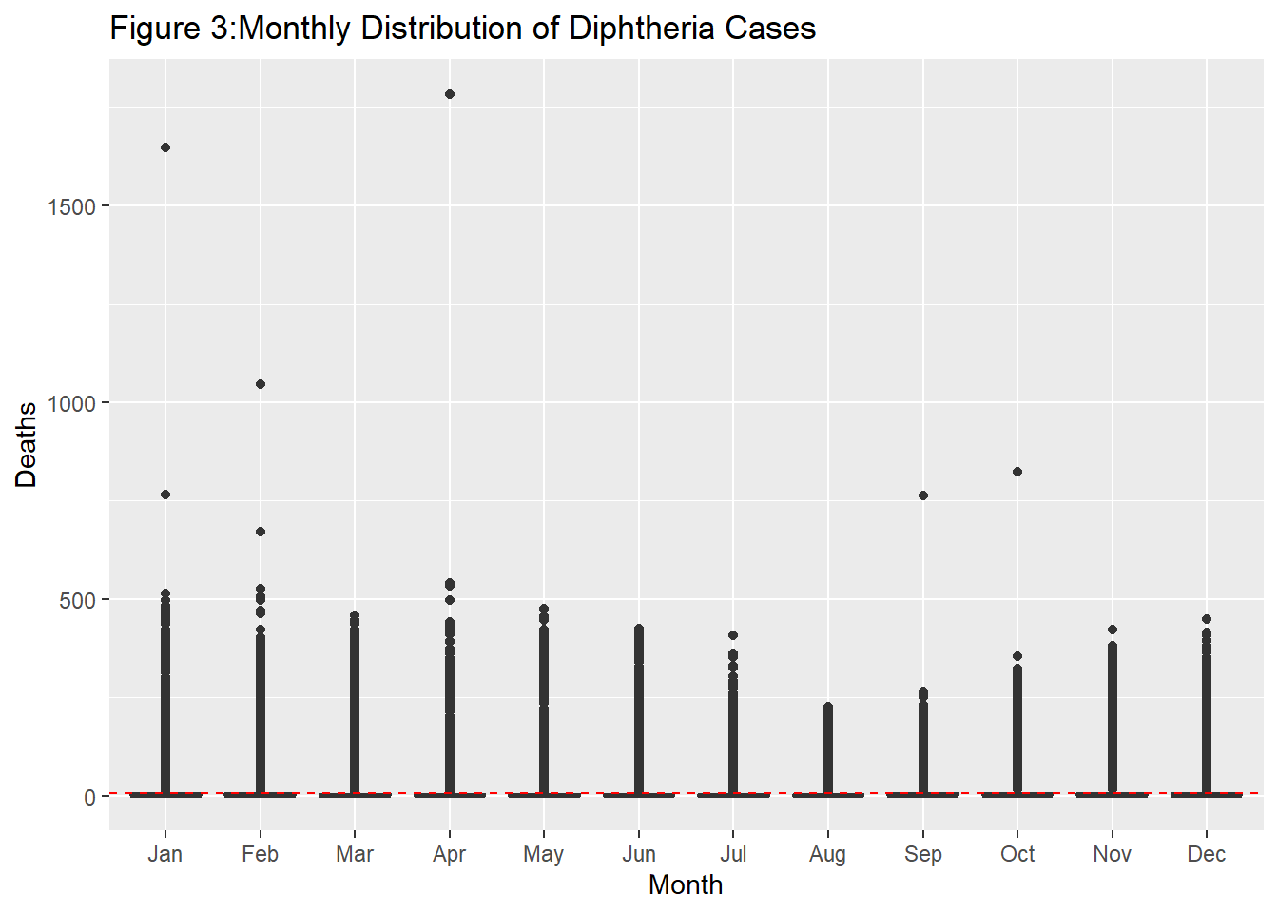
Monthly Distribution via Boxplot
Seasonal peaks in colder months.
Boxplot reveals higher median deaths in winter.
Evidence for RQ2: Seasonality.

Slide 8
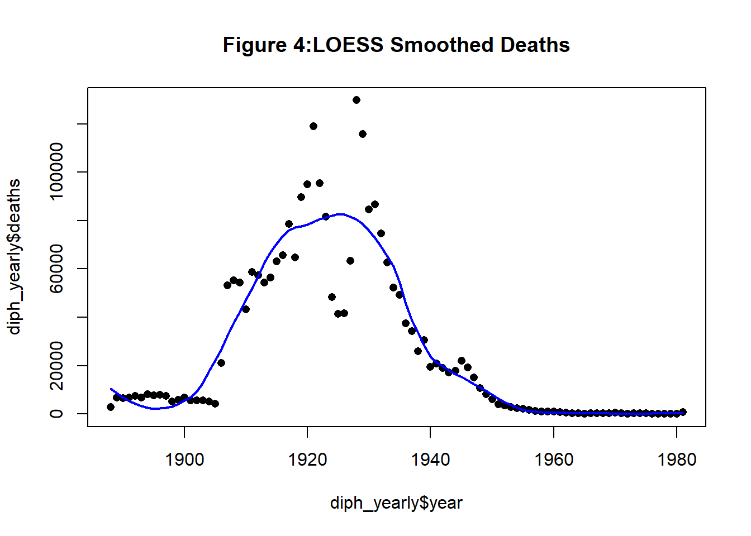
LOESS Smoothed Trend
Non-parametric smoothing shows a sharp decline.
Steady decrease starting ~1940.
Visualizes long-term trend without assuming a linear relationship.

Slide 9
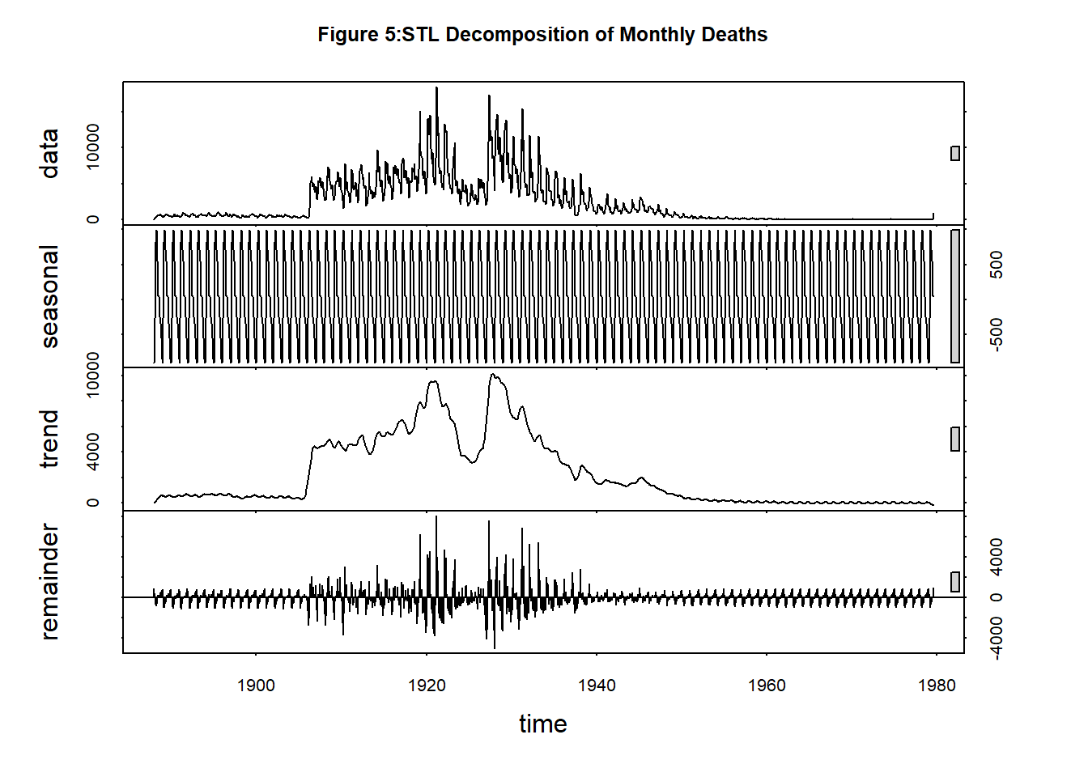
STL Decomposition
STL is particularly powerful in epidemiology for separating cyclical disease patterns from secular changes such as policy interventions or population immunity.. The seasonal plot highlights consistent winter peaks, while the trend confirms a long-term decline.
The trend component confirms a long-term decline in mortality, while the remainder represents noise or anomalies.

Slide 10
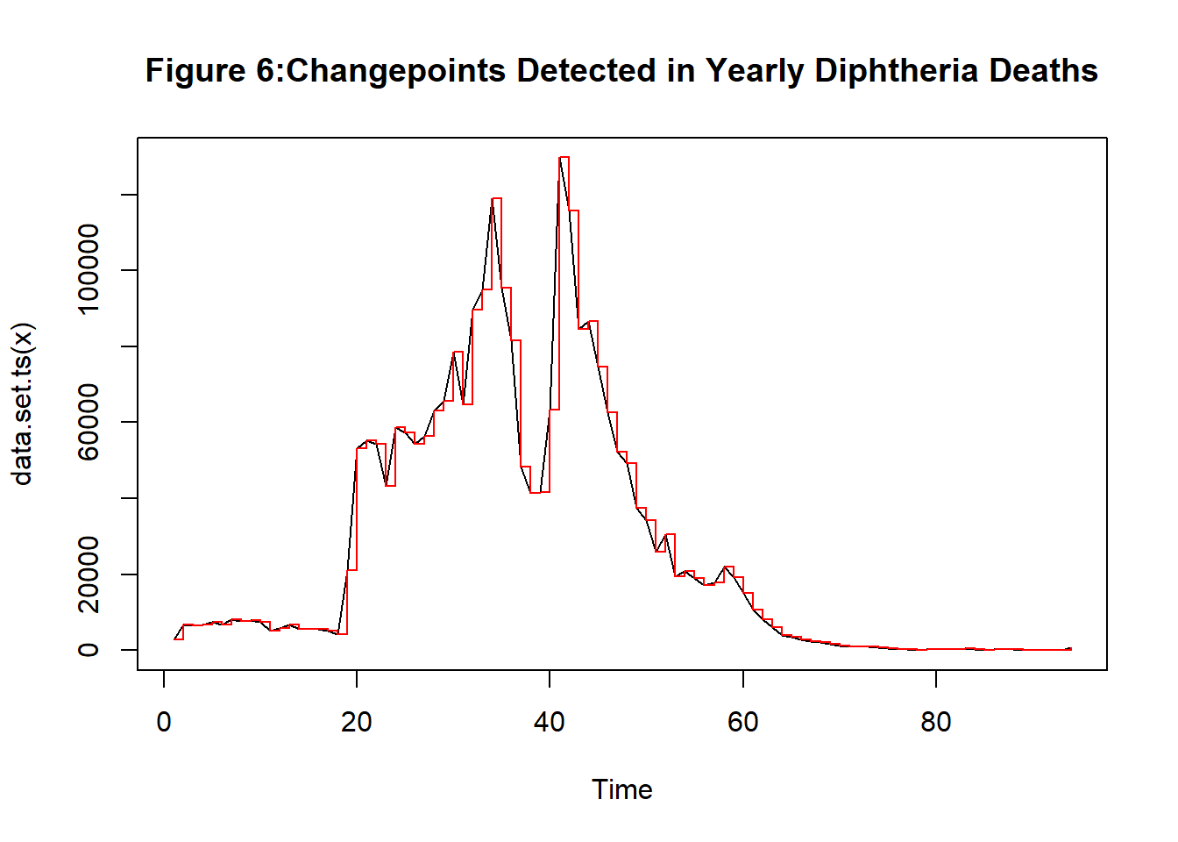
Changepoint Detection
Changepoints identified ~1925 and ~1940.
Corresponds to vaccine development and rollout.
Quantifies significant structural breaks.

Slide 11
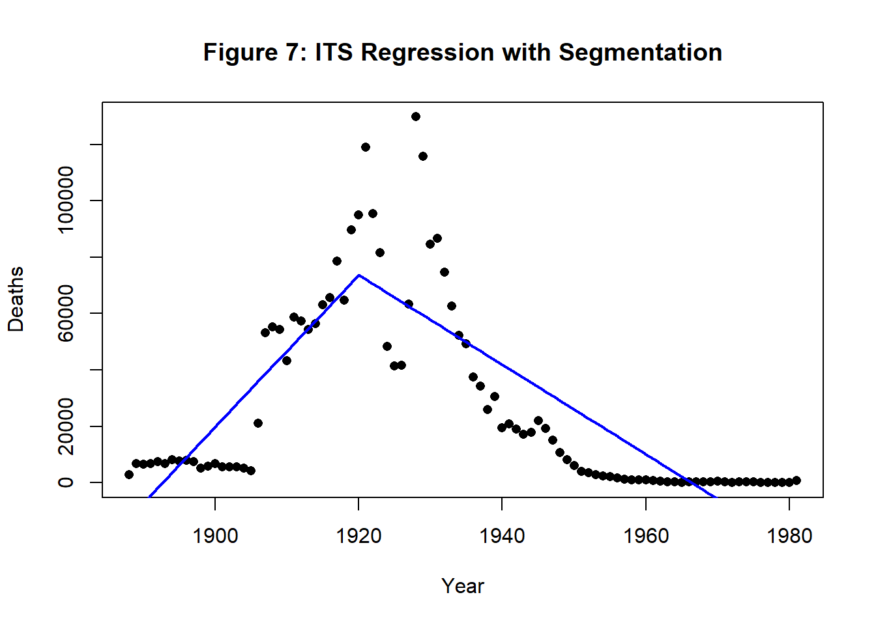
Interrupted Time-Series Regression
The fitted lines demonstrate a sharp decrease in the rate of deaths, with a statistically significant drop in both intercept and trend post-1940.
This provides strong statistical evidence for the effectiveness of vaccination in reducing diphtheria mortality. with a segmented regression line.

Slide 12
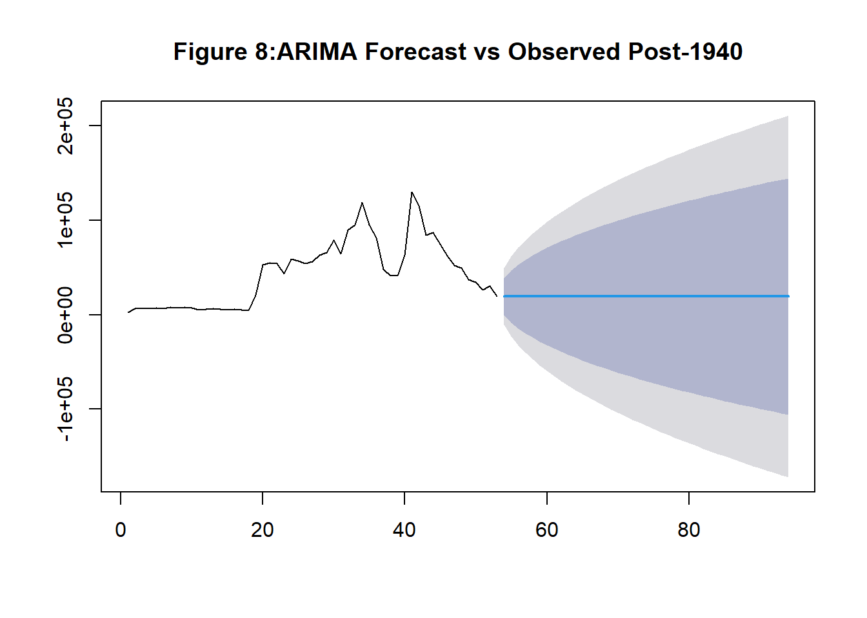
ARIMA Forecast Counterfactual
It presents an ARIMA forecast based on pre-1940 data to simulate a counterfactual trend—what might have occurred without vaccination.
This model not only illustrates the effectiveness of the intervention but also quantifies potential lives saved.
The observed values post-1940 fall dramatically below predicted values, demonstrating the intervention’s effectiveness.

Slide 13
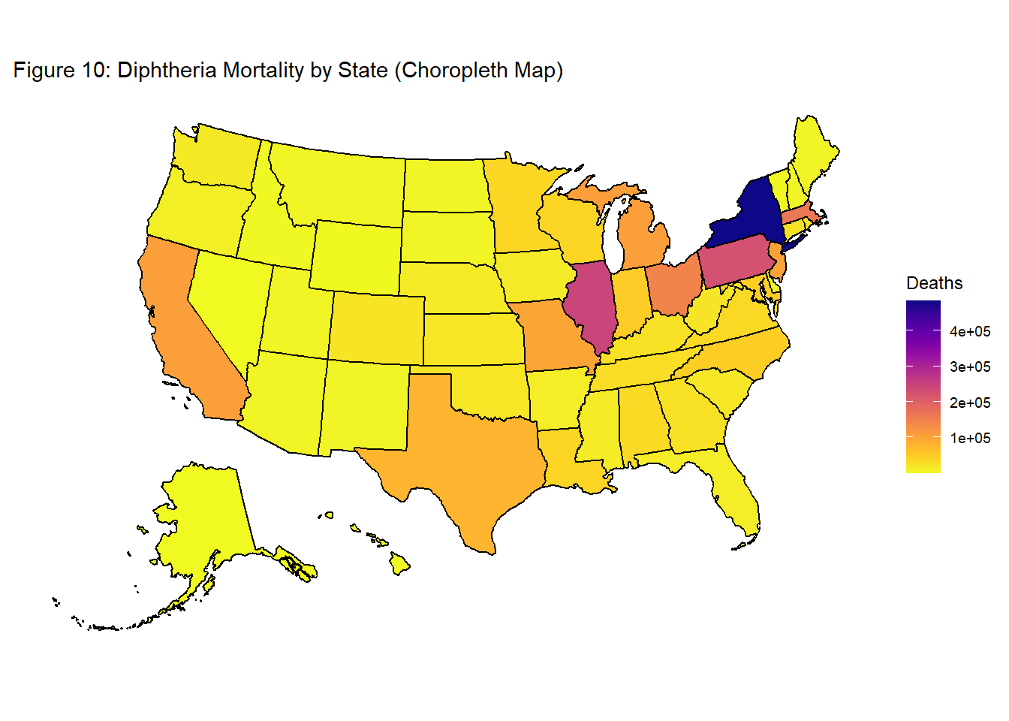
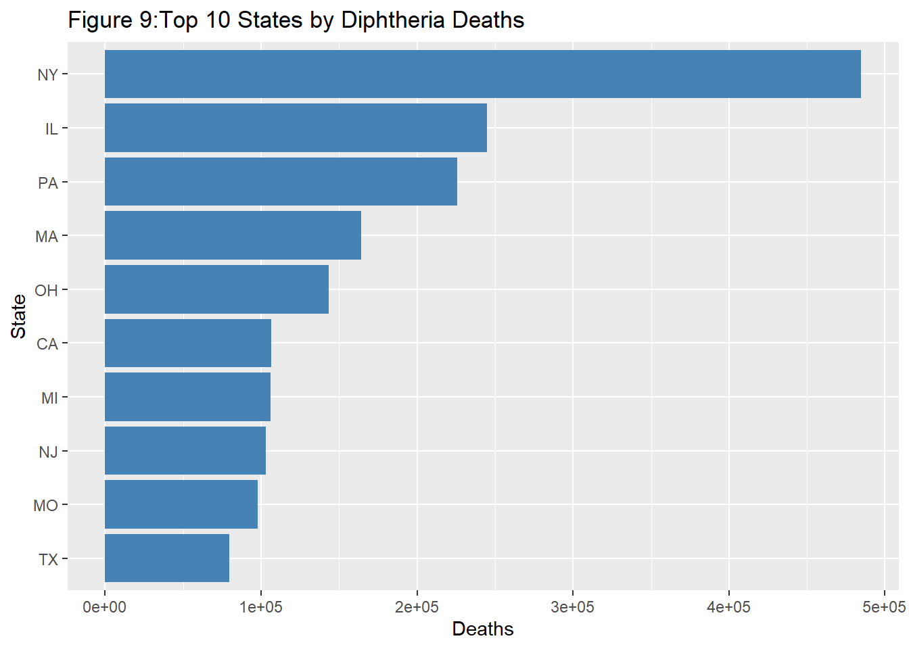
Top 10 States by Deaths & Choropleth Map by Death Rate
Summarizing the total deaths by state allows us to quickly see geographic disparities and to focus further analysis on the areas with the highest burden.
We used a choropleth map to display mortality geographically across all U.S. states in a more intuitive, spatial format. Unlike the bar chart, the map allows for immediate visual comparison and helps highlight regional clusters or patterns. Each state is shaded according to its total diphtheria deaths, with darker colors representing higher mortality.

Slide 14
Key Findings and Conclusions
✅ Annual deaths fell sharply after 1940 ✅ Clear seasonality with winter peaks ✅ Changepoint & ITS analysis confirm vaccination impact ✅ Urban centers had the highest burden ✅ ARIMA forecast shows strong counterfactual evidence
Vaccination campaigns led to dramatic mortality reduction.
Time series methods effectively capture historical interventions.
Geographic and seasonal insights deepen understanding of epidemic dynamics.

Slide 15
References
Roush, S. W., & Murphy, T. V. (2007). Historical comparisons of morbidity and mortality for vaccine-preventable diseases in the United States. JAMA, 298(18), 2155–2163.
Project Tycho. https://www.tycho.pitt.edu.
Orenstein, W. A., & Ahmed, R. (2017). Simply put: Vaccines save lives. PNAS, 114(16), 4031–4033.
Fine, P. E. M., Eames, K., & Heymann, D. L. (2011). “Herd immunity”: a rough guide. Clinical Infectious Diseases, 52(7), 911–916.

